Slide 1
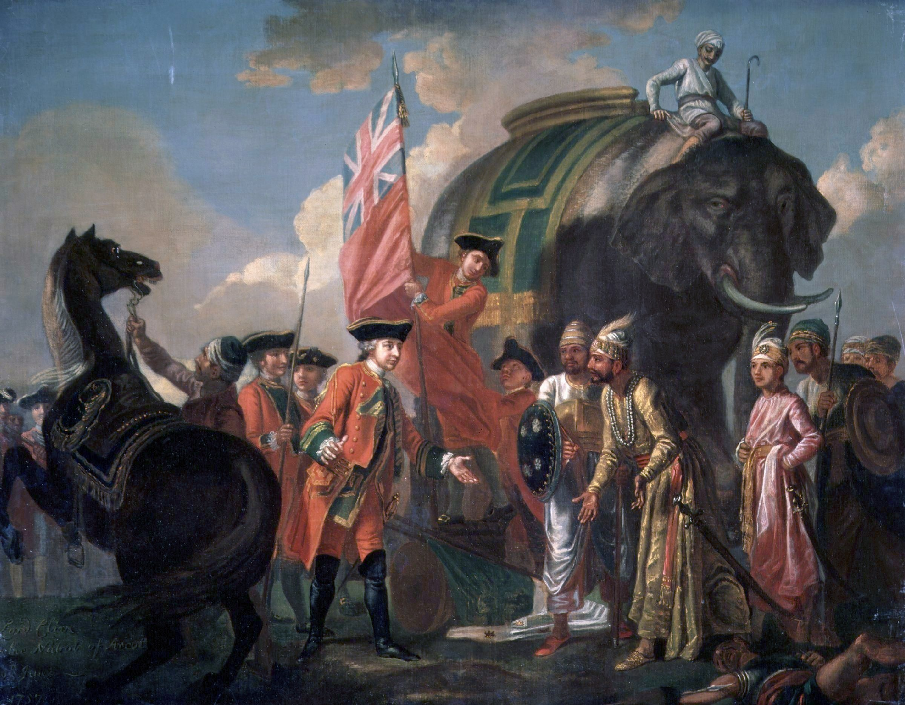
British Rule in India
-Group “G”

Slide 2
Hypothesis
The British Rule had Negative Impact in India

Slide 3
Questions regarding this Case
Did British Rule leave India better off economically than when they arrived?
Did British Rule leave India better off socially than when they arrived?

Slide 4
Pre-British Era Economic Condition of India
Before British colonial rule, India was the major contributor of the world’s economy.
According British economist Angus Maddison, during Pre-British era India accounted for 25% of World’s GDP.
Before British colonization, India was the largest producer and exporter of world’s finest fabric “Muslin”.
People were free to choose occupation.
Prices of essential daily commodities were quite low, so that people were able meet their daily requirements.

Slide 5
British Era Economic Condition of India
Monopolistic trade policy.
De-industrialized India by discouraging Indian manufacturer.
Destruction of handicraft industry.
Limited employment opportunity for Indian.
Spend more in military, police and justice rather than agriculture.

Slide 6
Pre-British Era Social Condition of India
India was a bunch of feuding princely states.
India had the most divided and oppressed/oppressing caste system.
Judiciary was not good, most of the time it was biased on basis of caste, relative and gender. Patil used to give justice at village level. Peshwas were head of Judiciary system.
Women of all caste/class were considered ati-shudras. That was male dominance culture.
India enjoyed world’s most sought after delicious food, richly garnished with salt, sugar, spices; along with nutritious fruits and vegetables.

Slide 7
Pre-British Era Social Condition of India
Here in India all the natives enjoyed the multicolored, climate friendly cotton and silk textiles; soaking and evaporating sweat simultaneously.
Before arrival of the British; Indians were enjoying, the coveted four ashrams of life; Brahmcharya, Grahasth, Sanyas, and Vanprasth. All have so much so time, energy and enthusiasm, that they created monument, which is still unmatchable wonder, of known history.
Artisans, Singers, Dancers etc. were getting rewards and patronage from King. (These things stopped during British period. Most of Artisans etc. got jobless.)
There was nothing like united country India, there was Mysore, there was Delhi, there was Rajputana etc., but not India.
There were fights and battles for Thrones, mostly everywhere. So, common people have to be ready to defend their Kingdom and provide food to the soldiers.

Slide 8
British Era Social Condition of India
Without British rule, there wouldn’t have been a political union called India.
The British were the first to establish newspapers in India, catering to a small English-educated elite first, and large audiences in the vernacular languages.
Surely, though, you can’t deny that the British gave us railways, tea, cricket, and the English language
Universities were established in Calcutta, Bombay and Madras (1857).
Sanskrit was promoted and several educational institutions were set up for that purpose. William Jones founded the Asiatic Society

Slide 9
British Era Social Condition of India
India’s contact with the West made educated Indians realise that socio-religious reform was a prerequisite for the all-round development of the country.
They introduced railways, steamships on the rivers and set about improving roads. Work on the Grand Trunk Road from Calcutta to Delhi was begun in 1839 and completed in the 1850s.
The first telegraph line from Calcutta to Agra was opened in 1853. The Post and Telegraph Department was also established in the same year.
To remove the defects of the revenue system, Lord Cornwallis introduced a new system of revenue collection in Bengal, Bihar and Orissa, known as the Permanent Settlement.
Indian markets were flooded with cheap, machine-made textiles manufactured in England. Indian hand-made textiles could not compete with the cheap machine-made textiles.

Slide 10
Decision about the Case
While there were definitely some good impacts from the british rule, but definitely the story which goes around in Britain, “the colonisation of India - as horrible as it may have been - was not of any major economic benefit to Britain itself. If anything, the administration of India was a cost to Britain. So the fact that the empire was sustained for so long - the story goes - was a gesture of Britain's benevolence” is a lie.
If we look closely, all the things we might say as benefits are actually by products of what actually the british did for good of their trade, and the negative economic impacts specially far outweighs the positive, while social impacts are debatable.
The upshot of the empire, as Tharoor puts it, was that “What had once been one of the richest and most industrialised economies of the world, which together with China accounted for almost 75% of world industrial output in 1750, had been reduced by the depredations of imperial rule to one of the poorest, most backward, illiterate and diseased societies on Earth by the time of independence in 1947.”

Slide 11
Thank you!
Any questions?

